Slide 1
Fundamental of Programming (ACS-102)

Slide 2
Repetition Structures (LOOPs)
Nested Loops

Slide 3
Nested Repetition Structures (Nested Loops)
In a nested repetition structure, one loop (inner loop) is placed entirely within another loop (outer loop)
In nested loops any loop (for, while, or do loop) can be placed inside another loop which can be a for, while, or a do loop

Slide 4
Nested Loop
A loop within another loop is called a nested loop. Let's take an example,
Suppose we want to loop through each day of a week for 3 weeks.
To achieve this, we can create a loop to iterate three times (3 weeks). And inside the loop, we can create another loop to iterate 7 times (7 days). This is how we can use nested loops.

Slide 5
#include <iostream>
using namespace std;
int main()
{
int weeks = 3, days_in_week = 7;
for (int i = 1; i <= weeks; ++i)
{
cout << "Week: " << i << endl;
for (int j = 1; j <= days_in_week; ++j)
{
cout << " Day:" << j << endl;
}
}
return 0; }

Slide 6
Nested Repetition Structures (Nested Loops) - Example
for (int i=0; i<2; i++)
{
for (int j=0; j<2;j++)
{
cout<<“\nHello-”<<i<<“:“<<j;
}
}
Outer Loop
Inner Loop

Slide 7
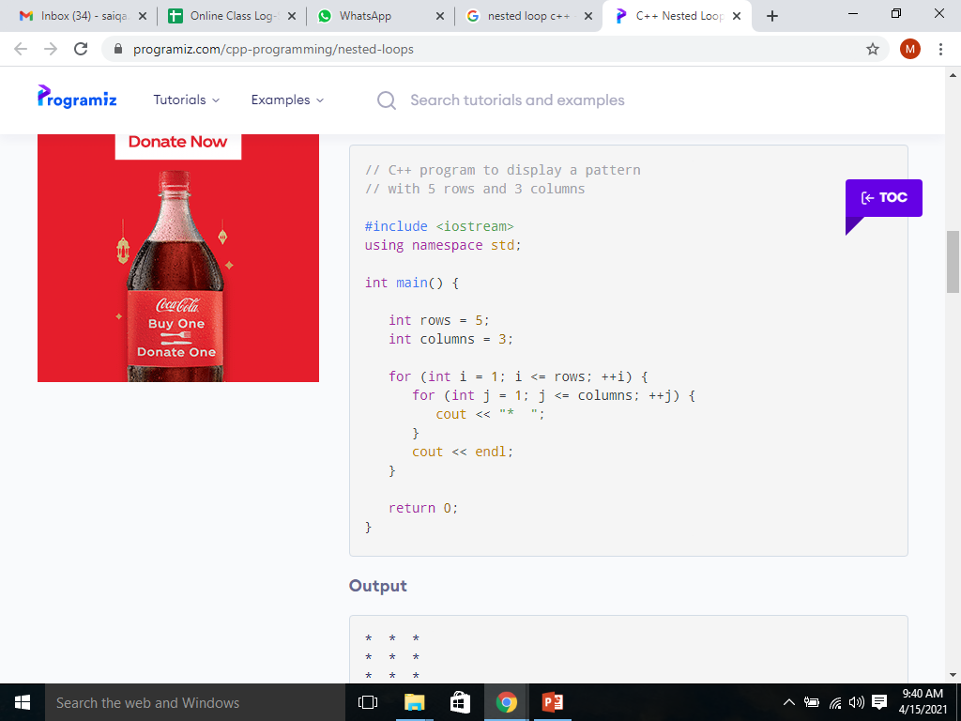
Guess output

Slide 8
(Nested Loops) – Example Program-1
Write a program to print triangle of starts.
*
**
***
****
*****
******
*******
********
*********

Slide 9
(Nested Loops) – Example Program-2
Write a program to print triangle of starts.
*********
********
*******
******
*****
****
***
**
*

Slide 10
(Nested Loops) – Example Program-3
Write a program to print Rectangle based on two triangles (One using + and other using * symbol).
+********
++*******
+++******
++++*****
+++++****
++++++***
+++++++**
++++++++*
+++++++++

